Slide 1
Distributional Semantics - Introduction
Week 7, Lecture 1

Slide 2
Introduction
What is Semantics?
The study of meaning: Relation between symbols and their denotata. John told Mary that the train moved out of the station at 3 o’clock.
Week 7, Lecture 1
2 / 14

Slide 3
Computational Semantics
Computational Semantics
The study of how to automate the process of constructing and reasoning with meaning representations of natural language expressions.
Methods in Computational Semantics generally fall in two categories: Formal Semantics: Construction of precise mathematical models of the relations between expressions in a natural language and the world.
John chases a bat → ∃x[bat(x) ∧ chase(john, x)]
Distributional Semantics: The study of statistical patterns of human word usage to extract semantics.
Week 7, Lecture 1
3 / 14

Slide 4
Distributional Hypothesis
Distributional Hypothesis: Basic Intuition
“The meaning of a word is its use in language.” (Wittgenstein, 1953)
“You know a word by the company it keeps.” (Firth, 1957)
→ Word meaning (whatever it might be) is reflected in linguistic distributions.
“Words that occur in the same contexts tend to have similar meanings.” (Zellig Harris, 1968)
→ Semantically similar words tend to have similar distributional patterns.
Week 7, Lecture 1
4 / 14

Slide 5
Distributional Semantics: a linguistic perspective
“If linguistics is to deal with meaning, it can only do so through distributional analysis.” (Zellig Harris)
Week 7, Lecture 1
5 / 14

Slide 6
Distributional Semantics: a linguistic perspective
“If linguistics is to deal with meaning, it can only do so through distributional analysis.” (Zellig Harris)
“If we consider words or morphemes A and B to be more different in meaning than A and C, then we will often find that the distributions of A and B are more different than the distributions of A and C. In other words, difference in meaning correlates with difference of distribution.” (Zellig Harris, “Distributional Structure”)
Differential and not referential
Week 7, Lecture 1
5 / 14

Slide 7
Distributional Semantics: a cognitive perspective
Contextual representation
A word’s contextual representation is an abstract cognitive structure that accumulates from encounters with the word in various linguistic contexts.
We learn new words based on contextual cues
He filled the wampimuk with the substance, passed it around and we all drunk some.
We found a little wampimuk sleeping behind the tree.
Week 7, Lecture 1
6 / 14

Slide 8
Distributional Semantic Models (DSMs)
Computational models that build contextual semantic repesentations from corpus data
DSMs are models for semantic representations
⁾ The semantic content is represented by a vector
⁾ Vectors are obtained through the statistical analysis of the linguistic contexts of a word
Alternative names
⁾ corpus-based semantics
⁾ statistical semantics
⁾ geometrical models of meaning
⁾ vector semantics
⁾ word space models
Distributional Semantics - Introduction
Week 7, Lecture 1
7 / 14

Slide 9
Distributional Semantics: The general intuition
Distributions are vectors in a multidimensional semantic space, that is, objects with a magnitude and a direction.
The semantic space has dimensions which correspond to possible contexts, as gathered from a given corpus.
Week 7, Lecture 1

Slide 10
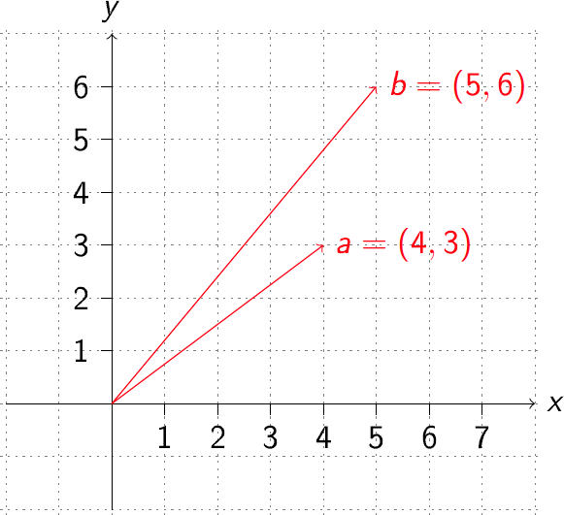
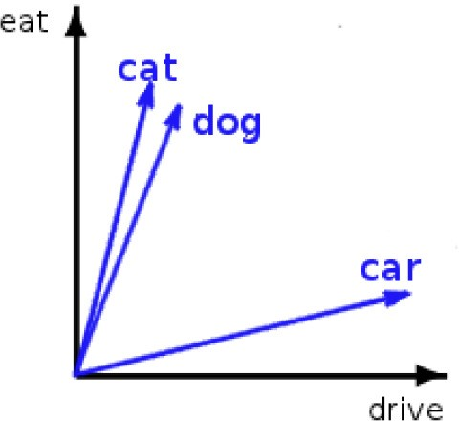
Vector Space
In practice, many more dimensions are used.
cat = [...dog 0.8, eat 0.7, joke 0.01, mansion 0.2,...]
Week 7, Lecture 1
9 / 14

Slide 11
Word Space
Small Dataset
An automobile is a wheeled motor vehicle used for transporting passengers .
A car is a form of transport , usually with four wheels and the capacity to carry around five passengers .
Transport for the London games is limited , with spectators strongly advised to avoid the use of cars .
The London 2012 soccer tournament began yesterday , with plenty of goals in the opening matches .
Giggs scored the first goal of the football tournament at Wembley , North London .
Bellamy was largely a passenger in the football match , playing no part in either goal .
Target words: ⟨automobile, car, soccer, football⟩
Term vocabulary : ⟨wheel, transport, passenger, tournament, London, goal, match⟩
Week 7, Lecture 1
10 / 14

Slide 12
Constructing Word spaces
Informal algorithm for constructing word spaces
Pick the words you are interested in: target words
Define a context window, number of words surrounding target word
⁾ The context can in general be defined in terms of documents, paragraphs or sentences.
Count number of times the target word co-occurs with the context words:
co-occurrence matrix
Build vectors out of (a function of) these co-occurrence counts
Week 7, Lecture 1
11 / 14

Slide 13
Constructing Word spaces: distributional vectors
distributional matrix = targets X contexts
 | wheel | transport | passenger | tournament | London | goal | match
automobile | 1 | 1 | 1 | 0 | 0 | 0 | 0
car | 1 | 2 | 1 | 0 | 1 | 0 | 0
soccer | 0 | 0 | 0 | 1 | 1 | 1 | 1
football | 0 | 0 | 1 | 1 | 1 | 2 | 1
Week 7, Lecture 1
12 / 14

Slide 14
2.5
² football (0,2)
1.5
goal
1 soccer (0,1)
0.5
automobile (1,0)
car (2,0)
0
0
0.5
1
transport
1.5
2
2.5
Week 7, Lecture 1
13 / 14

Slide 15
Computing similarity
 | wheel | transport | passenger | tournament | London | goal | match
automobile | 1 | 1 | 1 | 0 | 0 | 0 | 0
car | 1 | 2 | 1 | 0 | 1 | 0 | 0
soccer | 0 | 0 | 0 | 1 | 1 | 1 | 1
football | 0 | 0 | 1 | 1 | 1 | 2 | 1
Using simple vector product
automobile . car = 4
automobile . soccer = 0
automobile . football = 1
car . soccer = 1
car . football = 2
soccer . football = 5
Week 7, Lecture 1
14 / 14

Slide 16
Distributional Models of Semantics
Week 7, Lecture 2

Slide 17
Vector Space Model without distributional similarity
Words are treated as atomic symbols
One-hot representation
Week 7, Lecture 2
2 / 19

Slide 18
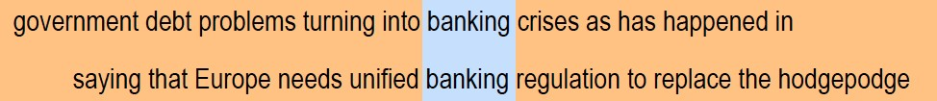
Distributional Similarity Based Representations
You know a word by the company it keeps
These words will represent banking
Week 7, Lecture 2
3 / 19

Slide 19
Building a DSM step-by-step
The “linguistic” steps
Pre-process a corpus (to define targets and contexts)
⇓
Select the targets and the contexts
The “mathematical” steps
Count the target-context co-occurrences
⇓
Weight the contexts (optional)
⇓
Build the distributional matrix
⇓
Reduce the matrix dimensions (optional)
⇓
Compute the vector distances on the (reduced) matrix
Week 7, Lecture 2
4 / 19

Slide 20
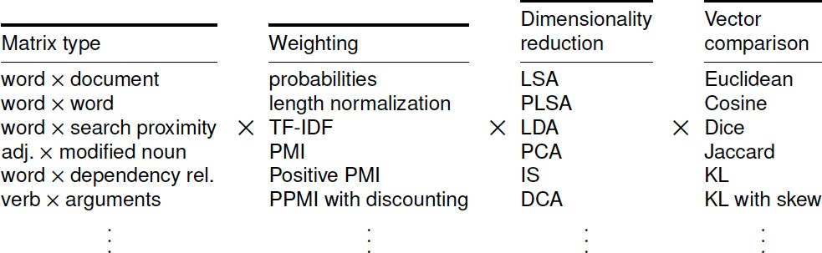
Many design choices
General Questions
How do the rows (words, ...) relate to each other?
How do the columns (contexts, documents, ...) relate to each other?
Week 7, Lecture 2
5 / 19

Slide 21
The parameter space
A number of parameters to be fixed
Which type of context? Which weighting scheme? Which similarity measure?
...
A specific parameter setting determines a particular type of DSM (e.g. LSA, HAL, etc.)
Week 7, Lecture 2

Slide 22
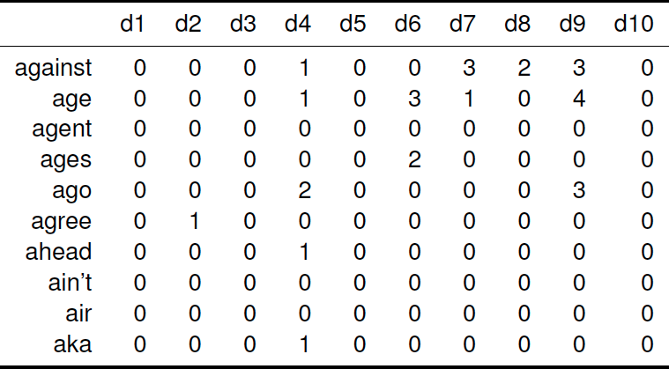
Documents as context: Word × document
Week 7, Lecture 2

Slide 23
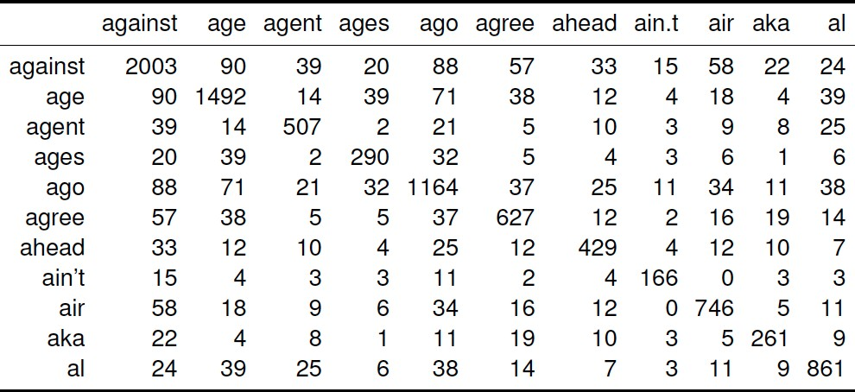
Words as context: Word × Word
Week 7, Lecture 2

Slide 24
Words as contexts
Parameters
Window size
Window shape - rectangular/triangular/other
Consider the following passage
Suspected communist rebels on 4 July 1989 killed Col. Herminio Taylo, police chief of Makati, the Philippines major financial center, in an escalation of street violence sweeping the Capitol area. The gunmen shouted references to the rebel New People’s Army. They fled in a commandeered passenger jeep. The military says communist rebels have killed up to 65 soldiers and police in the Capitol region since January.
Week 7, Lecture 2
9 / 19

Slide 25
Words as contexts
Parameters
Window size
Window shape - rectangular/triangular/other
5 words window (unfiltered): 2 words either side of the target word Suspected communist rebels on 4 July 1989 killed Col. Herminio Taylo, police chief of Makati, the Philippines major financial center, in an escalation of street violence sweeping the Capitol area. The gunmen shouted references to the
rebel New People’s Army. They fled in a commandeered passenger jeep. The military says communist rebels have killed up to 65 soldiers and police in the Capitol region since January.
Pawan Goyal (IIT Kharagpur)
Week 7, Lecture 2
9 / 19

Slide 26
Words as contexts
Parameters
Window size
Window shape - rectangular/triangular/other
5 words window (filtered): 2 words either side of the target word
Suspected communist rebels on 4 July 1989 killed Col. Herminio Taylo, police chief of Makati, the Philippines major financial center, in an escalation of street violence sweeping the Capitol area. The gunmen shouted references to the rebel New People’s Army. They fled in a commandeered passenger jeep. The military says communist rebels have killed up to 65 soldiers and police in the Capitol region since January.
Week 7, Lecture 2

Slide 27
Context weighting: documents as context
Indexing function F: Essential factors
Word frequency (f_{ij}): How many times a word appears in the document?
F ∝ f_{ij}
Document length (|D_{i}|): How many words appear in the document?
F ∝
1
|Di|
Document frequency (N_{j}): Number of documents in which a word
appears. F ∝ ¹
Nj
Indexing Weight: tf-Idf
N
f ∗ log( ) for each term, normalize the weight in a document with
ij
Nj
respect to L₂-norm.
Week 7, Lecture 2
10 / 19

Slide 28
Context weighting: words as context
basic intuition
word1 word2
freq(1,2)
freq(1)
freq(2)
dog dog
small domesticated
855 33,338 490,580
29 33,338 918
Week 7, Lecture 2
11 / 19

Slide 29
Context weighting: words as context
basic intuition
Association measures are used to give more weight to contexts that are more significantly associted with a targer word.
The less frequent the target and context element are, the higher the weight given to their co-occurrence count should be.
⇒ Co-occurrence with frequent context element small is less informative than co-occurrence with rarer domesticated.
different measures - e.g., Mutual information, Log-likelihood ratio
Week 7, Lecture 2
11 / 19

Slide 30
Pointwise Mutual Information (PMI)
PMI(w₁, w₂) = log₂ ^{Pcorpus(w1, w2)}
P_{ind} (w₁, w₂)
PMI(w₁, w₂) = log₂ ^{Pcorpus(w1, w2)}
Pcorpus(w1)Pcorpus(w2)
_{Pcorpus(w1, w2) =} freq(w₁, w₂)
N
_{Pcorpus(w) =} freq(w)
N
Week 7, Lecture 2
12 / 19

Slide 31
PMI: Issues and Variations
Positive PMI
All PMI values less than zero are replaced with zero.
Bias towards infrequent events
Consider w_{j} having the maximum association with w_{i}, Pcorpus(wi) ≈ Pcorpus(wj) ≈ Pcorpus(wi, wj)
PMI increases as the probability of w_{i} decreases.
Also, consider a word w_{j} that occurs once in the corpus, also in the context of
w_{i}. A discounting factor proposed by Pantel and Lin:
_{δij =} f_{ij} min(f_{i}, f_{j})
f_{ij} + 1 min(f_{i}, f_{j}) + 1
PMI_{new}(w_{i}, w_{j}) = δ_{ij}PMI(w_{i}, w_{j})
Week 7, Lecture 2
13 / 19

Slide 32
Distributional Vectors: Example
Normalized Distributional Vectors using Pointwise Mutual Information
petroleum | oil:0.032 gas:0.029 crude:0.029 barrels:0.028 exploration:0.027 barrel:0.026 opec:0.026 refining:0.026 gasoline:0.026 fuel:0.025 natural:0.025 exporting:0.025
drug | trafficking:0.029 cocaine:0.028 narcotics:0.027 fda:0.026 police:0.026 abuse:0.026 marijuana:0.025 crime:0.025 colombian:0.025 arrested:0.025 addicts:0.024
insurance | insurers:0.028 premiums:0.028 lloyds:0.026 reinsurance:0.026 underwriting:0.025 pension:0.025 mortgage:0.025 credit:0.025 investors:0.024 claims:0.024 benefits:0.024
forest | timber:0.028 trees:0.027 land:0.027 forestry:0.026 environmental:0.026 species:0.026 wildlife:0.026 habitat:0.025 tree:0.025 mountain:0.025 river:0.025 lake:0.025
robotics | robots:0.032 automation:0.029 technology:0.028 engineering:0.026 systems:0.026 sensors:0.025 welding:0.025 computer:0.025 manufacturing:0.025 automated:0.025
Week 7, Lecture 2
14 / 19

Slide 33
Distributional Semantics: Applications, Structured Models
Week 7, Lecture 3

Slide 34
Application to Query Expansion: Addressing Term Mismatch
Term Mismatch Problem in Information Retrieval
Stems from the word independence assumption during document indexing. User query: insurance cover which pays for long term care.
A relevant document may contain terms different from the actual user query. Some relevant words concerning this query: {medicare, premiums, insurers}
Week 7, Lecture 3
2 / 15

Slide 35
Application to Query Expansion: Addressing Term Mismatch
Term Mismatch Problem in Information Retrieval
Stems from the word independence assumption during document indexing. User query: insurance cover which pays for long term care.
A relevant document may contain terms different from the actual user query. Some relevant words concerning this query: {medicare, premiums, insurers}
Using DSMs for Query Expansion
Given a user query, reformulate it using related terms to enhance the retrieval performance.
The distributional vectors for the query terms are computed.
Expanded query is obtained by a linear combination or a functional combination of these vectors.
Week 7, Lecture 3
2 / 15

Slide 36
Query Expansion using Unstructured DSMs
TREC Topic 104: catastrophic health insurance
Query Representation: surtax:1.0 hcfa:0.97 medicare:0.93 hmos:0.83 medicaid:0.8 hmo:0.78 beneficiaries:0.75 ambulatory:0.72 premiums:0.72 hospitalization:0.71 hhs:0.7 reimbursable:0.7 deductible:0.69
Broad expansion terms: medicare, beneficiaries, premiums . . .
Specific domain terms: HCFA (Health Care Financing Administration), HMO
(Health Maintenance Organization), HHS (Health and Human Services)
TREC Topic 355: ocean remote sensing
Query Representation: radiometer:1.0 landsat:0.97 ionosphere:0.94 cnes:0.84 altimeter:0.83 nasda:0.81 meterology:0.81 cartography:0.78 geostationary:0.78 doppler:0.78 oceanographic:0.76
Broad expansion terms: radiometer, landsat, ionosphere . . .
Specific domain terms: CNES (Centre National dÉtudes Spatiales) and NASDA
(National Space Development Agency of Japan)
Week 7, Lecture 3
3 / 15

Slide 37
Similarity Measures for Binary Vectors
Let X and Y denote the binary distributional vectors for words X and Y.
Similarity Measures
Dice coefficient : ^{2|X∩Y|}
|X|+|Y|
Jaccard Coefficient : ^{|X∩Y|}
|X∪Y|
Overlap Coefficient : _{min}^{|X∩Y|}
(|X|,|Y|)
Jaccard coefficient penalizes small number of shared entries, while Overlap coefficient uses the concept of inclusion.
Week 7, Lecture 3
4 / 15

Slide 38
Similarity Measures for Vector Spaces
Let →X and →Y denote the distributional vectors for words X and Y.
→X = [x₁, x₂, . . . , x_{n}], →Y = [y₁, y₂, . . . , y_{n}]
Similarity Measures
Cosine similarity : cos(→X,→Y) = ^{X¯·→Y}
√
|→X||→Y|
→ →
n
Euclidean distance : |X − Y| = Σ (x_{i} − y_{i})²
i=1
Week 7, Lecture 3
5 / 15

Slide 39
Similarity Measure for Probability Distributions
Let p and q denote the probability distributions corresponding to two distributional vectors.
Similarity Measures
KL-divergence : D(p||q) = Σ p log
p
i i
i
qi
p+q
p+q
Information Radius : D(p|| ) + D
(q|| )
2
2
L₁-norm : Σ_{i}|p_{i} − q_{i}|
Week 7, Lecture 3
6 / 15

Slide 40
Attributional Similarity vs. Relational Similarity
Attributional Similarity
The attributional similarity between two words a and b depends on the degree of correspondence between the properties of a and b.
Ex: dog and wolf
Relational Similarity
Two pairs(a, b) and (c, d) are relationally similar if they have many similar relations.
Ex: dog: bark and cat: meow
Week 7, Lecture 3

Slide 41
Relational Similarity: Pair-pattern matrix
Pair-pattern matrix
Row vectors correspond to pairs of words, such as mason: stone and
carpenter: wood
Column vectors correspond to the patterns in which the pairs occur, e.g.
X cuts Y and X works with Y
Compute the similarity of rows to find similar pairs
Extended Distributional Hypothesis; Lin and Pantel
Patterns that co-occur with similar pairs tend to have similar meanings.
This matrix can also be used to measure the semantic similarity of patterns.
Given a pattern such as “X solves Y”, you can use this matrix to find similar patterns, such as “Y is solved by X”, “Y is resolved in X”, “X resolves Y”.
Week 7, Lecture 3
8 / 15

Slide 42
Structured DSMs
Basic Issue
Words may not be the basic context units anymore
How to capture and represent syntactic information?
X solves Y and Y is solved by X
An Ideal Formalism
Should mirror semantic relationships as close as possible
Incorporate word-based information and syntactic analysis Should be applicable to different languages
Use Dependency grammar framework
Week 7, Lecture 3
9 / 15

Slide 43
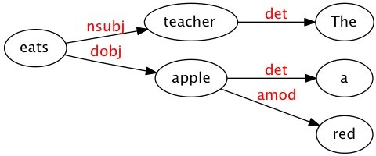
Structured DSMs
Using Dependency Structure: How does it help?
The teacher eats a red apple.
‘eat’ is not a legitimate context for ‘red’.
The ‘object’ relation connecting ‘eat’ and ‘apple’ is treated as a different type of co-occurrence from the ‘modifier’ relation linking ‘red’ and ‘apple’.
Week 7, Lecture 3
10 / 15

Slide 44
Structured DSMs
Structured DSMs: Words as ‘legitimate’ contexts
Co-occurrence statistics are collected using parser-extracted relations.
To qualify as context of a target item, a word must be linked to it by some (interesting) lexico-syntactic relation
Week 7, Lecture 3
11 / 15

Slide 45
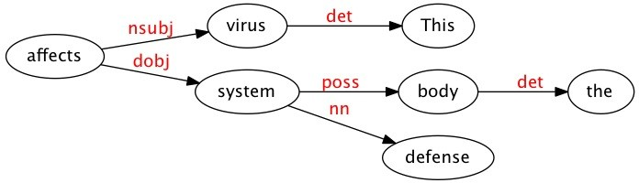
Structured DSMs
Distributional models, as guided by dependency
Ex: For the sentence ‘This virus affects the body’s defense system.’, the dependency parse is:
Word vectors
<system, dobj, affects> ...
Corpus-derived ternary data can also be mapped onto a 2-way matrix
Week 7, Lecture 3
12 / 15

Slide 46
2-way matrix
<system, dobj, affects>
<virus, nsubj, affects>
The dependency information can be dropped
<system, dobj, affects> ⇒ <system, affects>
<virus, nsubj, affects> ⇒ <virus, affects>
Link and one word can be concatenated and treated as attributes
virus={nsubj-affects:0.05,...}, system={dobj-affects:0.03,...}
Week 7, Lecture 3
13 / 15

Slide 47
Structured DSMs for Selectional Preferences
Selectional Preferences for Verbs
Most verbs prefer arguments of a particular type. This regularity is known as selectional preference.
From a parsed corpus, noun vectors are calculated as shown for ‘virus’ and ‘system’.
obj-carry 0.1
obj-buy 0.4
obj-drive 0.8
obj-eat 0.02
obj-store sub-fly . . .
0.2 0.05 . . .
. . .
. . .
. . .
car vegetable biscuit
· · ·
0.3
0.4
. . .
0.5
0.4
. . .
0
0
. . .
0.6
0.5
. . .
0.3
0.4
. . .
0.05
0.02
. . .
Week 7, Lecture 3
14 / 15

Slide 48
Structured DSMs for Selectional Preferences
Selectional Preferences
Suppose we want to compute the selectional preferences of the nouns as object of verb ‘eat’.
n nouns having highest weight in the dimension ‘obj-eat’ are selected, let
{vegetable, biscuit,. . .} be the set of these n nouns.
The complete vectors of these n nouns are used to obtain an ‘object prototype’ of the verb.
‘object prototype’ will indicate various attributes such as these nouns can be consumed, bought, carried, stored etc.
Similarity of a noun to this ‘object prototype’ is used to denote the plausibility of that noun being an object of verb ‘eat’.
Week 7, Lecture 3
15 / 15

Slide 49
Word Embeddings - Part I
Week 7, Lecture 4

Slide 50
Word Vectors
At one level, it is simply a vector of weights.
In a simple 1-of-N (or ‘one-hot’) encoding every element in the vector is associated with a word in the vocabulary.
The encoding of a given word is simply the vector in which the corresponding element is set to one, and all other elements are zero.
One-hot representation
Week 7, Lecture 4
2 / 19

Slide 51
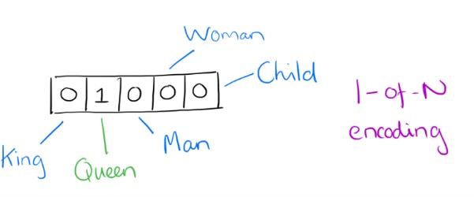
Word Vectors - One-hot Encoding
Suppose our vocabulary has only five words: King, Queen, Man, Woman, and Child.
We could encode the word ‘Queen’ as:
Week 7, Lecture 4

Slide 52
Limitations of One-hot encoding
Word vectors are not comparable
Using such an encoding, there is no meaningful comparison we can make between word vectors other than equality testing.
Week 7, Lecture 4
4 / 19

Slide 53
Word2Vec – A distributed representation
Distributional representation – word embedding?
Any word w_{i} in the corpus is given a distributional representation by an embedding
w_{i} ∈ R^{d}
i.e., a d−dimensional vector, which is mostly learnt!
Week 7, Lecture 4
5 / 19

Slide 54
Distributional Representation
Take a vector with several hundred dimensions (say 1000).
Each word is represented by a distribution of weights across those elements.
So instead of a one-to-one mapping between an element in the vector and a word, the representation of a word is spread across all of the elements in the vector, and
Each element in the vector contributes to the definition of many words.
Week 7, Lecture 4

Slide 55
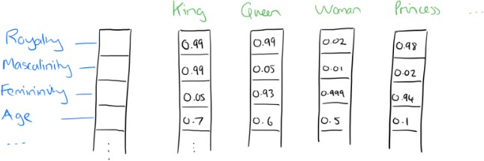
Distributional Representation: Illustration
If we label the dimensions in a hypothetical word vector (there are no such pre-assigned labels in the algorithm of course), it might look a bit like this:
Such a vector comes to represent in some abstract way the ‘meaning’ of a word
Week 7, Lecture 4

Slide 56
Word Embeddings
d typically in the range 50 to 1000
Similar words should have similar embeddings
SVD can also be thought of as an embedding method
Week 7, Lecture 4
8 / 19

Slide 57
Reasoning with Word Vectors
It has been found that the learned word representations in fact capture meaningful syntactic and semantic regularities in a very simple way.
Specifically, the regularities are observed as constant vector offsets between pairs of words sharing a particular relationship.
Case of Singular-Plural Relations
If we denote the vector for word i as x_{i}, and focus on the singular/plural relation, we observe that
xapple − xapples ≈ xcar − xcars ≈ xfamily − xfamilies ≈ xcar − xcars
and so on.
Week 7, Lecture 4
9 / 19

Slide 58
Reasoning with Word Vectors
Perhaps more surprisingly, we find that this is also the case for a variety of semantic relations.
Good at answering analogy questions
a is to b, as c is to ?
man is to woman as uncle is to ? (aunt)
A simple vector offset method based on cosine distance shows the relation.
Week 7, Lecture 4
10 / 19

Slide 59
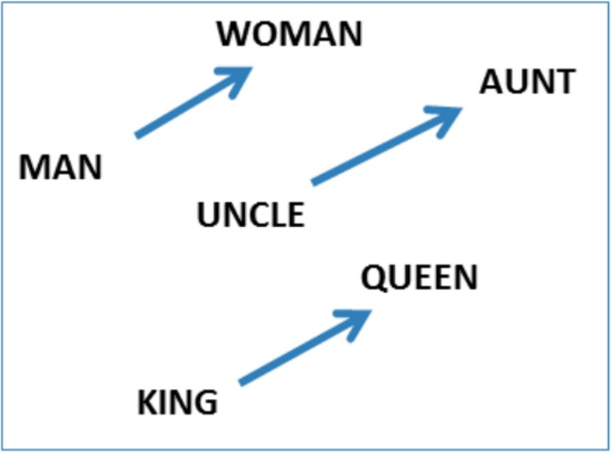
Vcctor Offset for Gender Relation
Week 7, Lecture 4
11 / 19

Slide 60
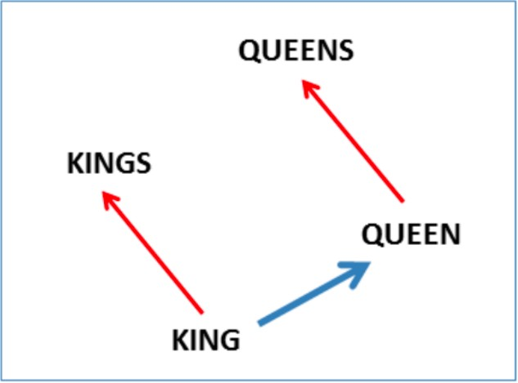
Vcctor Offset for Singular-Plural Relation
Week 7, Lecture 4
12 / 19

Slide 61
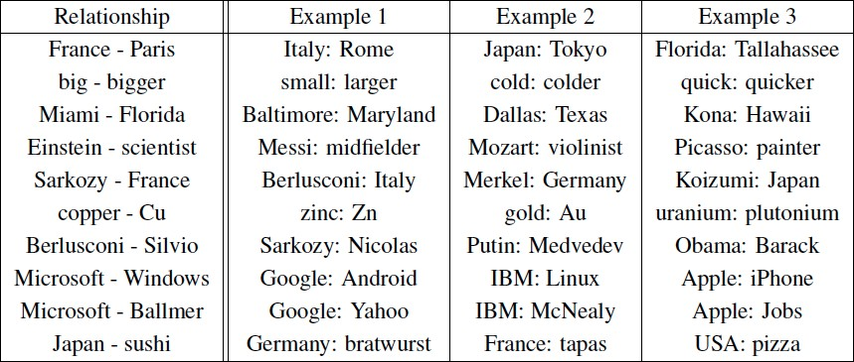
Encoding Other Dimensions of Similarity
Analogy Testing
Week 7, Lecture 4
13 / 19

Slide 62
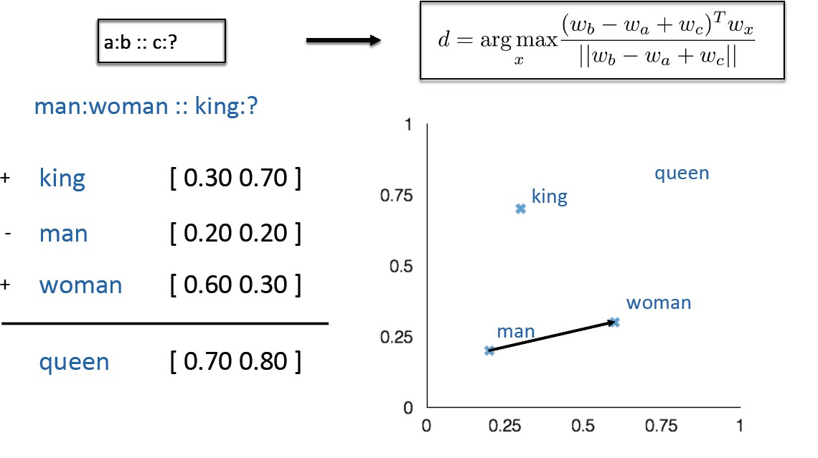
Analogy Testing
Week 7, Lecture 4
14 / 19

Slide 63
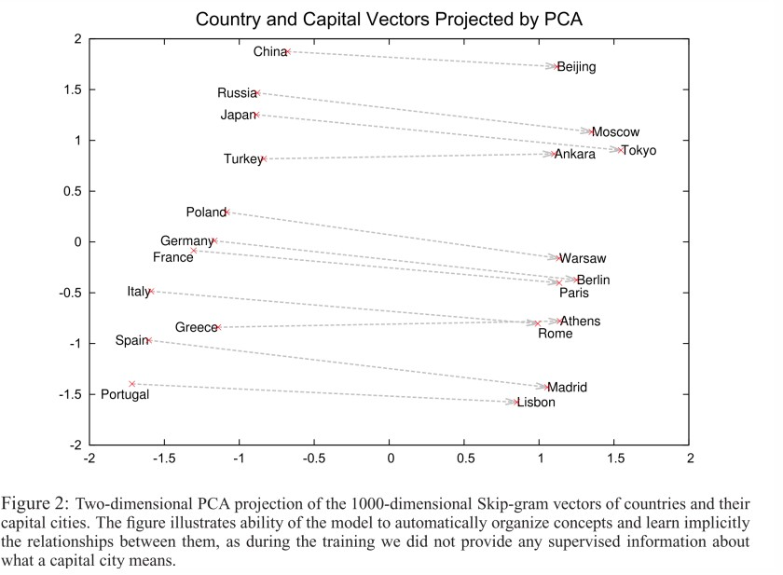
Country-capital city relationships
Week 7, Lecture 4
15 / 19

Slide 64
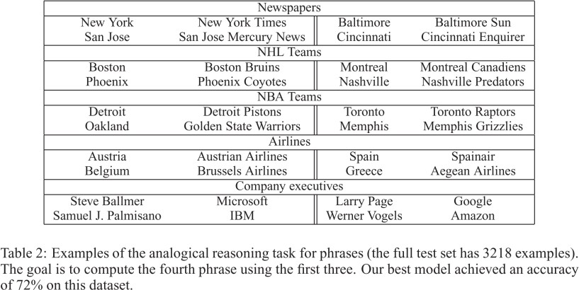
More Analogy Questions
Week 7, Lecture 4
16 / 19

Slide 65
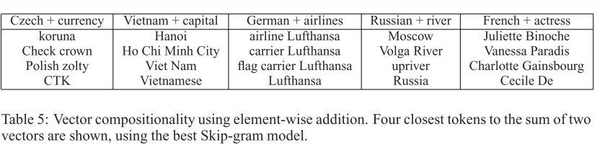
Element Wise Addition
We can also use element-wise addition of vector elements to ask questions such as ‘German + airlines’ and by looking at the closest tokens to the composite vector come up with impressive answers:
Week 7, Lecture 4
17 / 19

Slide 66
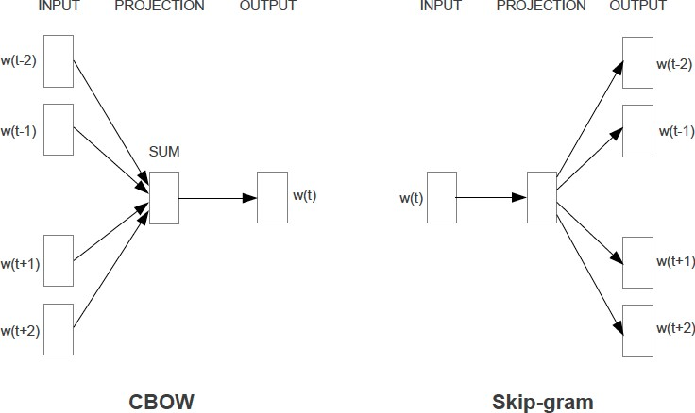
Two Variations: CBOW and Skip-grams
Week 7, Lecture 4
19 / 19

Slide 67
Word Embedings - Part II
Week 7, Lecture 5

Slide 68
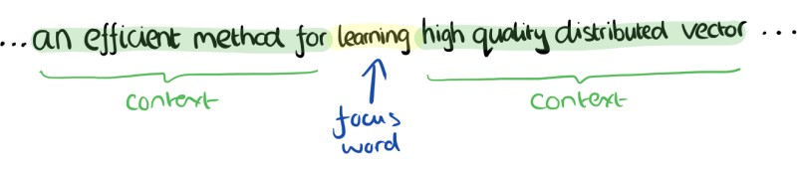
CBOW
Consider a piece of prose such as:
“The recently introduced continuous Skip-gram model is an efficient method for learning high-quality distributed vector representations that capture a large number of syntatic and semantic word relationships.”
Imagine a sliding window over the text, that includes the central word currently in focus, together with the four words that precede it, and the four words that follow it:
Week 7, Lecture 5
2 / 14

Slide 69
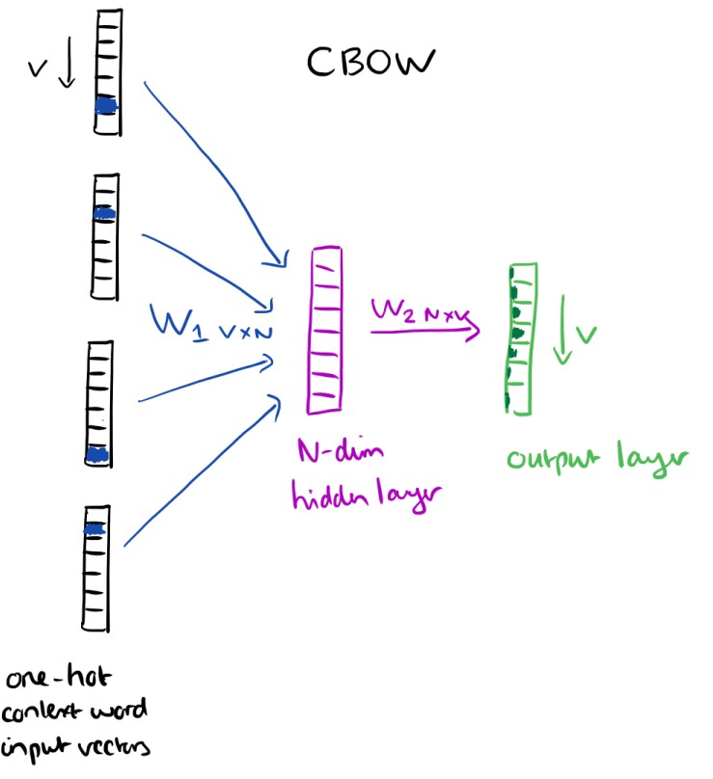
CBOW
The context words form the input layer. Each word is encoded in one-hot form. A single hidden and output layer.
Week 7, Lecture 5

Slide 70
CBOW: Training Objective
The training objective is to maximize the conditional probability of observing the actual output word (the focus word) given the input context words, with regard to the weights.
In our example, given the input (“an”, “efficient”, “method”, “for”, “high”, “quality”, “distributed”, “vector”), we want to maximize the probability of getting “learning” as the output.
Week 7, Lecture 5

Slide 71
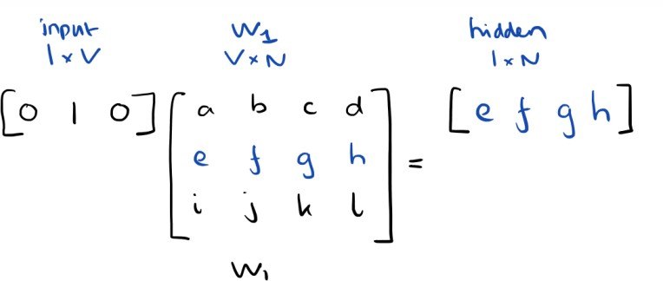
CBOW: Input to Hidden Layer
Since our input vectors are one-hot, multiplying an input vector by the weight matrix W₁ amounts to simply selecting a row from W₁.
Given C input word vectors, the activation function for the hidden layer h amounts to simply summing the corresponding ‘hot’ rows in W₁, and dividing by C to take their average.
Week 7, Lecture 5

Slide 72
CBOW: Hidden to Output Layer
From the hidden layer to the output layer, the second weight matrix W₂ can be used to compute a score for each word in the vocabulary, and softmax can be used to obtain the posterior distribution of words.
Week 7, Lecture 5

Slide 73
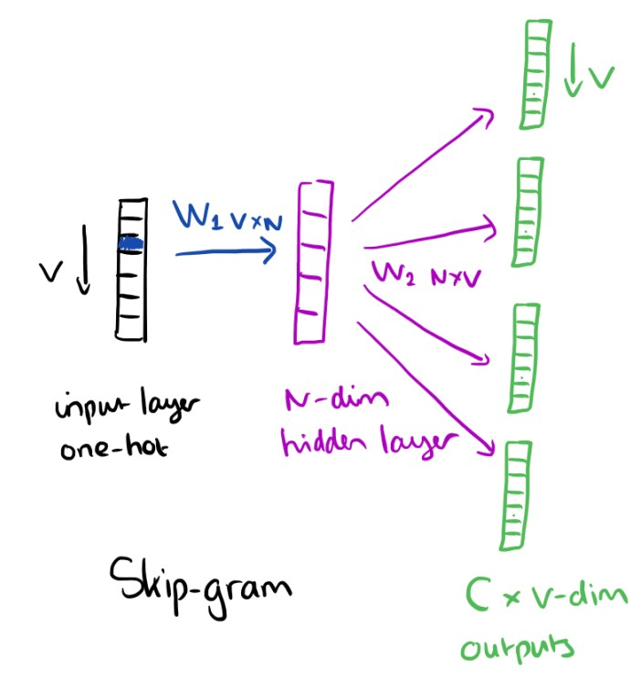
Skip-gram Model
The skip-gram model is the opposite of the CBOW model. It is constructed with the focus word as the single input vector, and the target context words are now at the output layer:
Week 7, Lecture 5

Slide 74
Skip-gram Model: Training
The activation function for the hidden layer simply amounts to copying the corresponding row from the weights matrix W₁ (linear) as we saw before. At the output layer, we now output C multinomial distributions instead of
just one.
The training objective is to mimimize the summed prediction error across all context words in the output layer. In our example, the input would be “learning”, and we hope to see (“an”, “efficient”, “method”, “for”, “high”, “quality”, “distributed”, “vector”) at the output layer.
Week 7, Lecture 5

Slide 75
Skip-gram Model
Details
Predict surrounding words in a window of length c of each word
Objective Function: Maximize the log probablility of any context word given the current center word:
1
T
J(θ) = _{T} ∑
∑
log p(w_{t+j}|w_{t})
t=1 −c≤j≤c,j=/ 0
Week 7, Lecture 5
9 / 14

Slide 76
Word Vectors
For p(w_{t+j}|w_{t}) the simplest first formulation is
exp(v′_{wO}^{T} v_{WI} )
p(w |w ) =
O I
∑
W
exp(v^{′ T}v_{WI} )
w=1 w
where v and v′ are “input” and “output” vector representations of w (so every word has two vectors)
Week 7, Lecture 5
10 / 14

Slide 77
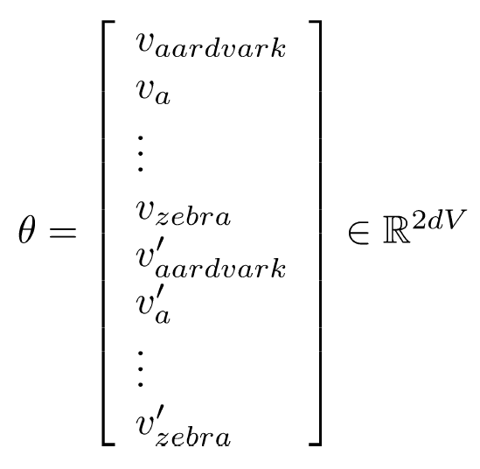
Parameters θ
With d−dimensional words and V many words:
Week 7, Lecture 5
11 / 14

Slide 78
Gradient Descent for Parameter Updates
∂
_{∂θj}old
new old
θ = θ −α
J(θ)
j j
Week 7, Lecture 5
12 / 14

Slide 79
Two sets of vectors
Best solution is to sum these up
L_{final} = L + L′
A good tutorial to understand parameter learning:
https://arxiv.org/pdf/1411.2738.pdf
An interactive Demo
https://ronxin.github.io/wevi/
Week 7, Lecture 5
13 / 14

Slide 80
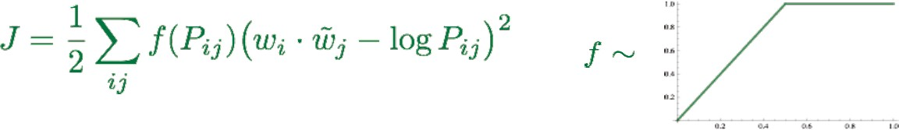
Glove
Combine the best of both worlds – count based methods as well as direct prediction methods
Week 7, Lecture 5
14 / 14

Slide 81
Glove
Combine the best of both worlds – count based methods as well as direct prediction methods
Fast training
Scalable to huge corpora
Good performance even with small corpus, and small vectors
Code and vectors: http://nlp.stanford.edu/projects/glove/
Week 7, Lecture 5
14 / 14

